Slide 1

Title- What are the typical steps for integrating SWC with BSW and generating RTE.
Presentation Made by :- Jyotisman Kirti Prakash
Group - 5 | Topics of each members
Ushashri N | Integrating SWC with BSW and Generating RTE in AUTOSAR Key Concepts: SWC, BSW, and RTE
Prince (C) | Typical Steps for SWC Integration with BSW RTE Generation Overview
Vikash | RTE Contract Phase RTE Generation Phase: Configuration Editing
Deepak | RTE Generation Phase: Code Generation Communication Setup via RTE
Suma | Runnable Mapping and Scheduling Summary and Best Practices

Slide 2
Integrating SWC with BSW and Generating RTE in AUTOSAR
This presentation outlines the typical steps involved in integrating Software Components (SWC) with Basic Software (BSW) and generating the Runtime Environment (RTE) within an AUTOSAR-compliant automotive system. We will explore the fundamental layers, the roles of each component, and the critical process of RTE generation that underpins seamless communication.

Slide 3



Key Concepts: SWC, BSW, and RTE
Software Components (SWC)
Basic Software (BSW)
Runtime Environment (RTE)
Provides hardware abstraction and essential services like communication, memory management, and diagnostics.
Application layer software units, designed to be independent of specific hardware, focusing on functional logic.
The crucial middleware that implements the Virtual Functional Bus (VFB), enabling communication between SWCs and BSW.

Slide 4

Typical Steps for SWC Integration with BSW
Define SWC Interfaces
1
Specify ports (sender/receiver, client/server) and runnables (executable code entities) for each SWC.
Map SWCs to ECUs
2
Assign SWC instances to specific Electronic Control Units (ECUs) and define their communication relationships.
Configure BSW Modules
3
Adjust BSW modules (e.g., COM, OS) to align with the specific needs and interfaces of the integrated SWCs.

Slide 5

RTE Generation Overview
RTE generation is a highly ECU-specific process, precisely tailored to how Software Components (SWCs) are deployed on a particular Electronic Control Unit. It involves two primary phases:
RTE Contract Phase: Defining the API between SWCs and RTE.
RTE Generation Phase: Creating the actual executable code.
Ultimately, the RTE guarantees seamless, abstract communication between SWCs and the underlying BSW modules, adhering to the Virtual Functional Bus concept.

Slide 6

RTE Contract Phase
1
Interface Definitions
Utilises AUTOSAR interface definitions to establish application header files.
2
Component API (Contract)
Defines the clear interface (contract) between each SWC and the RTE.
3
Hardware Independence
Enables SWC developers to implement source code without needing to know specific communication details.

Slide 7



RTE Generation Phase: Configuration Editing
Collect ECU Data
Resolve Dependencies
Configure Related Modules
Gather all necessary ECU configuration data, including SWC instances, runnables, events, and communication links.
Use specialised RTE Configuration Editor tools to resolve complex configuration dependencies and ensure consistency.
Properly configure related modules like the COM stack and the Operating System (OS) scheduler according to SWC needs.

Slide 8

RTE Generation Phase: Code Generation
Generate Source Files
Automatic generation of RTE source files (e.g., Rte.c, Rte.h) specifically for each ECU.
Map Runnables to OS Tasks
Assign SWC runnables to specific Operating System tasks, defining scheduling parameters like priority and preemption.
Implement Communication
Establish robust communication mechanisms for both intra-ECU (within the same ECU) and inter-ECU (between different ECUs) SWC interactions.

Slide 9



Communication Setup via RTE
Virtual Functional Bus
Interface Support
Exclusive Access
RTE implements the Virtual Functional Bus (VFB) connections, handling data transfer whether locally within an ECU or across networks (e.g., CAN, FlexRay).
Supports various interface types including client-server, sender-receiver, and mode switch for flexible interaction.
Ensures that SWCs can only access BSW services exclusively through the defined RTE interfaces, maintaining architectural integrity.

Slide 10
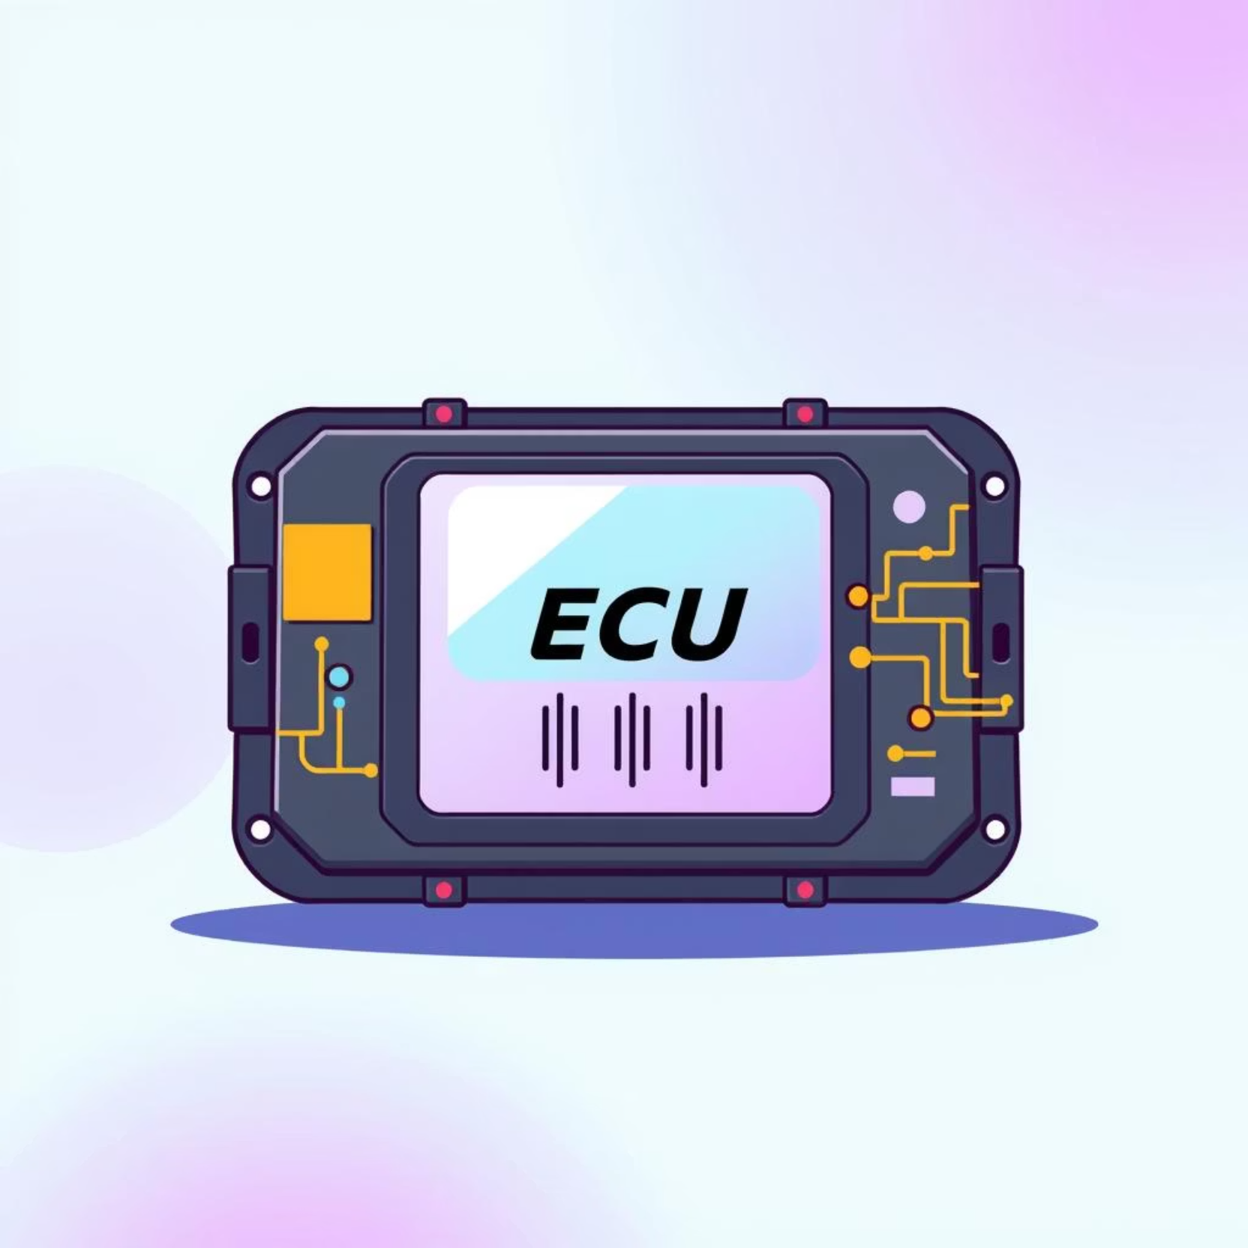
Runnable Mapping and Scheduling
OS Task Mapping
The RTE meticulously maps SWC runnables to specific Operating System tasks or events based on the system's configuration.
Triggering Mechanisms
Supports triggering runnables periodically (at fixed intervals) or on specific events, such as the reception of new data.
Scheduler Coordination
Coordinates seamlessly with the BSW scheduler to manage task execution and precise timing, optimising system performance.

Slide 11

Summary and Best Practices
Effective integration of SWC with BSW and RTE generation is pivotal for robust AUTOSAR systems.
Precise Configuration
Iterative Process
Requires meticulous SWC and ECU configuration before RTE generation.
RTE generation is iterative; changes in SWC necessitate regeneration.
Scalability & Reusability
Leverage Tools
Proper configuration ensures hardware independence, reusability, and system scalability.
Utilise AUTOSAR tools (e.g., DaVinci Configurator) for efficient integration.

